Slide 1
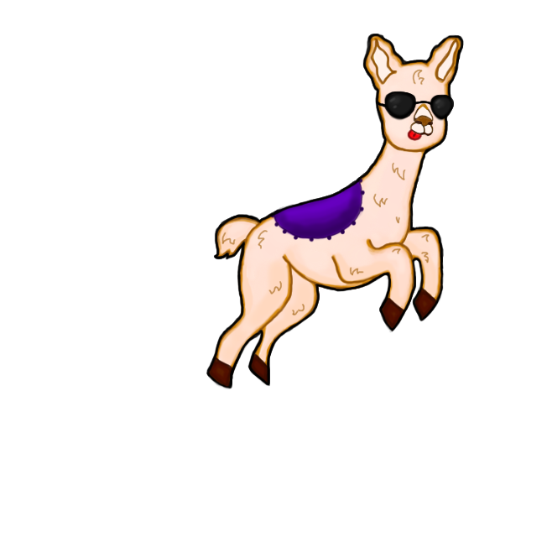
Leapin’ llamas Course Project for CSCI 352
Garret Hay
Anderson Taylor
Christina Hinton
Special Thanks to Kirsten Verleen for artwork

Slide 2
Background
WHAT?
Flappy Bird clone game featuring different skins and local high scores
INFO
Flappy Bird is a game where the player must keep a bird in flight while jumping over randomly spawning pipes.
WHY?
We thought a game would be both challenging and fun

Slide 3
Approach
We used WPF. In general, each screen serves a specific function with a few helper classes
We used timers in order to track player input, spawn the pipes, and for some simple animations
We used the Decorator pattern for the llama skins and the Strategy pattern to help implement the difficulty settings.

Slide 4
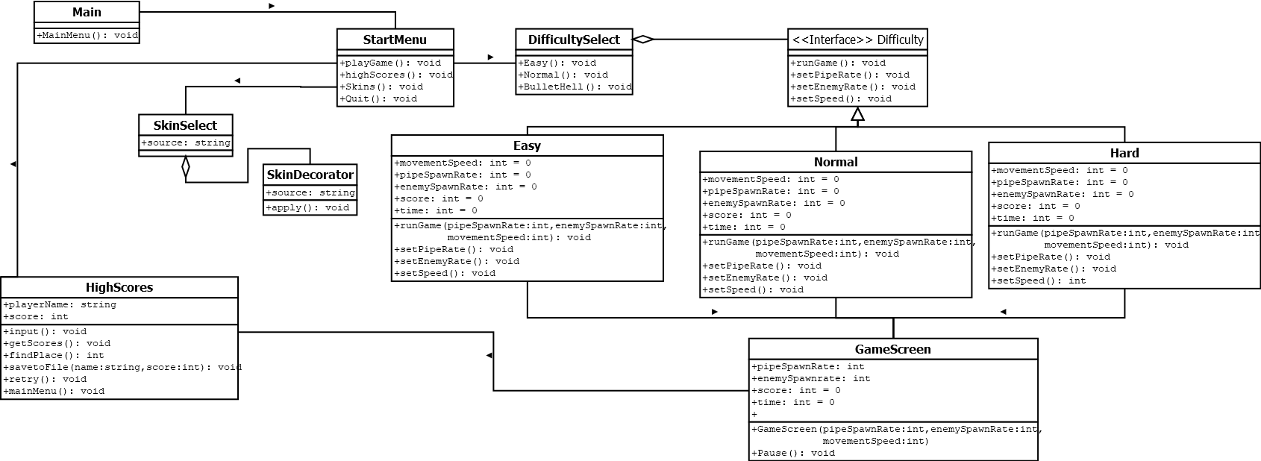
Class diagrams

Slide 5
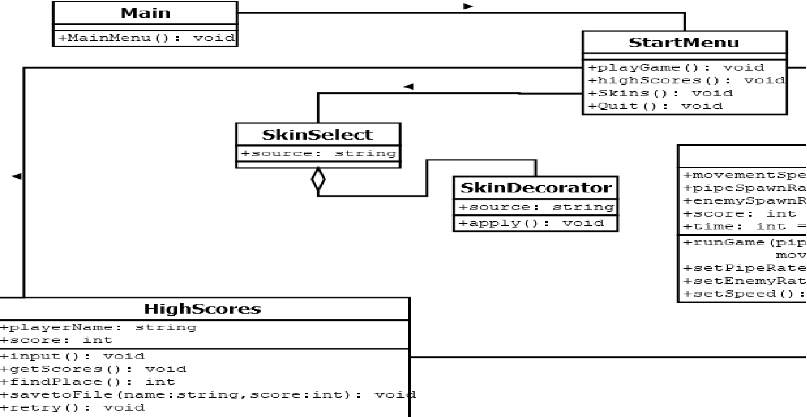
Class Diagrams

Slide 6
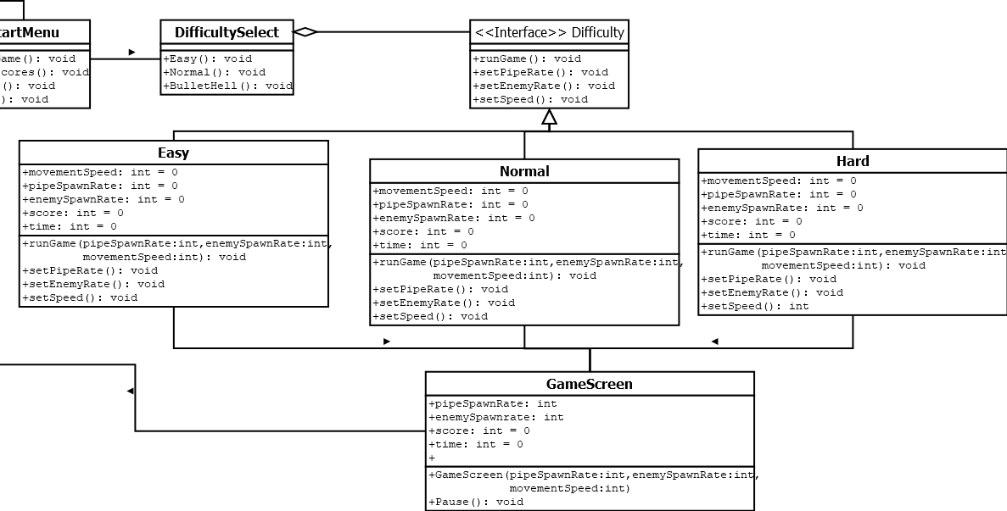
CLASS Diagrams

Slide 7
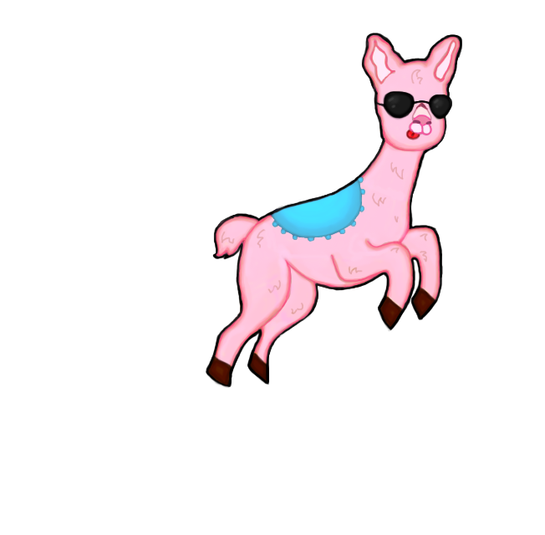
Demo

Slide 8
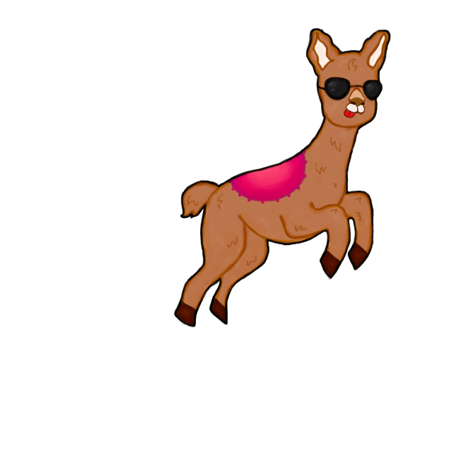
Future Work
Add music
Additional skins
Full-screen capabilities

Slide 9
Questions
Christina Hinton: chrmhint@ut.utm.edu
Anderson Taylor: andltayl@ut.utm.edu
Garret Hay: garlhay@ut.utm.edu
Github: https://github.com/andltayl/352Project

